Slide 1
TOTAL TRANSPORTATION SYSTEM
An Introduction

Slide 2
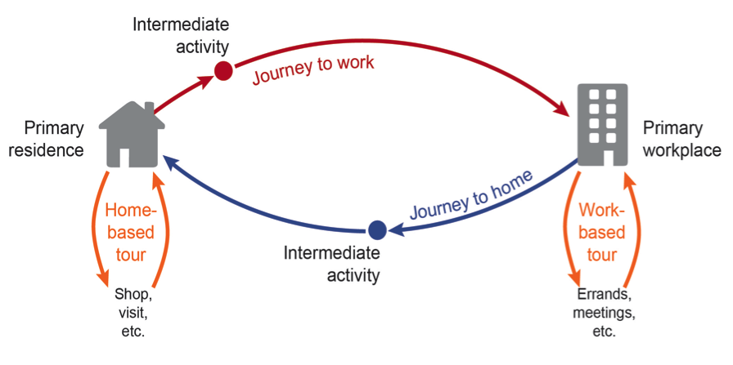
Transportation is (everything involved in) the action of moving either people or goods from an origin to a destination.

Slide 3
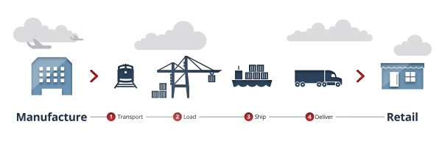
Transportation is (everything involved in) the action of moving either people or goods from an origin to a destination.

Slide 4
Transportation is complex in nature, covering multi-modal, multi-sector, multi-problem ..
Multi-modal: covering all modes of transport → air, land, and sea; passenger and freight
Multi-sector: encompassing the problems and viewpoints of government, private industry, and public
Multi-problem: ranging across a spectrum of issues that includes national and international policy, planning of regional system, the location and design of specific facilities, carrier management issues, regulatory, institutional and financial policies.
Manheim, 1979

Slide 5
.. and, therefore, dealing with multi-objective and requiring multi-disciplinary perspective.
Multi-objective: national and regional economic development, urban development, environment quality, social quality, service to users, financial and economic feasibility.
Multi-disciplinary: drawing on the theories and methods of engineering, economics, operation research, political science, psychology, other natural and social sciences, management and law.
Manheim, 1979

Slide 6
Transportation is also dynamic and interconnected internally as well as with other complex dynamic systems.
Vary in space and time, stochastic in nature.
Human decision-makers with complex decision calculi make choices that shape the transportation system.
Sussman, 2000

Slide 7
Therefore, to make transportation system works, we have to share the VIEW THAT ..

Slide 8
The basic premise is total transportation system of a region must be viewed as a single, multimodal system.
All modes of transportation
All elements:
Persons/goods being transported
Vehicles in which they conveyed
The network of facilities through which the vehicles/passengers/cargoes move, including terminals, transfer points, as well as line-haul facilities
All movements through the system (for all OD)
For each specific flow, the total trip, from point of origin to final destination, over all modes and facilities
Manheim, 1979

Slide 9
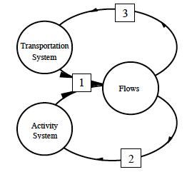
Manheim’s model illustrates the interconnection of transportation system with external dynamic systems: flow & activity.
The current pattern of flows is determined by the transportation and activity systems;
The current flow pattern will cause changes over time in the activity system;
The transportation system changes in response to actual or anticipated flows.
Manheim, 1979

Slide 10
Cascetta further explains the dynamic interconnection between transportation supply and demand and their relationship with the activity system
Consist not only of the physical and organizational elements that interact with each other to produce transportation opportunities, but also of the demand that takes advantage of such opportunities to travel from one place to another.
Can be defined as a set of elements and the interactions between them that produce both demand for travel within a given area and the provision of transportation services to satisfy this demand.
Cascetta, 2009

Slide 11
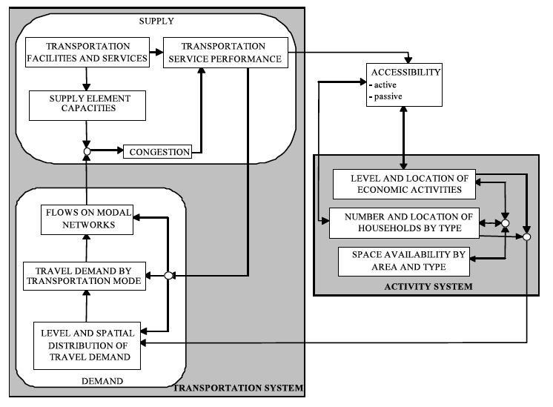
Cascetta, 2009
Notes:
Active accessibility: the generalized cost (disutility) of reaching other zones
Passive accessibility: the generalized cost (disutility) of being reached from other zones.

Slide 12
We must also understand transportation as a subsystem of the complex of social, economic, political, and other forces.
In Manheim (1979), the social, economic, political, and other forces were summarized as the activity system
Kusbiantoro (2011)*, on the other hand, placed those forces as external factors that may influence the total transportation system
Institutional system: legal, organization, personnel, and finance.
Externalities from local, regional, and international level: economy, social, culture, environment, and politics.

Slide 13
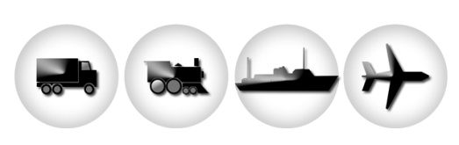
Nat / Int
Regional
External System: Economy-Social-Culture-Environment-Politics
Local
Activity
System
Network
System
Institutional
System
legal
organization
personnel
finance
Flow
System
Internal System: Economy-Social-Culture-Environment-Politics
Kusbiantoro, 2011

Slide 14
Transportation is not an end, but derived demand
Derived demand:
Individual scale: work, school, recreation, etc
Urban and regional scale: connecting housings to commercial/growth centers, connecting production processes from rural to urban area, etc.
The role of transportation:
Passive: serve the dynamic of activity system
Active: influence (positive) changes in activity system
Kusbiantoro, 2011

Slide 15
Fricker & Whitford (2004) illustrated transportation system as a simple stool with three legs.
One leg represents the components of the system
A second leg stands for those activities involved in putting a transportation system in place, from planning to operation and maintenance
The third leg identifies issues that may not be included in the transportation decision making processes, although they may be affected by the decisions → “externalities”
Fricker & Whitford, 2004

Slide 16

The Transportation System
Issues for Viability
Putting the System
In Place
Components of Transportation
Fricker & Whitford, 2004

Slide 17
The Transportation System
Modal Diversity
Vehicles
(Right-of-) Way
Power Control
Technology of Movement
Interconnection
Drivers
Pilots
Passengers
Freight
Issues for Viability
Putting the System
In Place
Components of Transportation
Fricker & Whitford, 2004

Slide 18
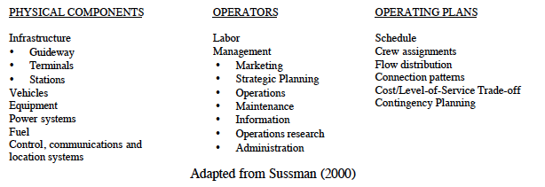
INTERNAL TRANSPORTATION SYSTEM COMPONENTS
Dodder, 2000

Slide 19
The Transportation System
Plan
Design
Invest
Operate
Maintain
Service Quality
Pricing
Consumer Demand
Issues for Viability
Putting the System
In Place
Components of Transportation
Fricker & Whitford, 2004

Slide 20
The Transportation System
Equity
Environment
Economics
International Trade
Resource Politics (Oil)
Labor
Industry Structure
Mobility
Disabilities
Issues for Viability
Putting the System
In Place
Components of Transportation
Fricker & Whitford, 2004

Slide 21
Transportation goals consist of:
Space or Location utility. Creating location utility or access.
Time utility. Providing maximum true trip speed → distance traveled divided by total travel time, including stops, delays and vehicle changes from origin to destination.
Cost utility. Cost-effective transportation → e.g. when the cost of moving goods from one origin to a destination causes goods to be non-competitive at the destination, the goods will not be shipped.
Fricker & Whitford, 2004

Slide 22
Transportasi sebagai Suatu Sistem
Sistem transportasi merupakan bentuk keterkaitan antara penumpang/barang, sarana dan prasarana yang saling berinteraksi dalam kegiatan perpindahan orang dan barang yang tercakup dalam satu tatanan, baik alamiah maupun rekayasa manusia.
Maksud penyelenggaraan sistem transportasi adalah mengkoordinasikan pergerakan barang/penumpang dengan mengatur komponen-komponennya.

Slide 23
Transportation systems analysis is a way to design or modify transportation system to meet the needs of the end user(s). It begins with:
System specifications
What is the purpose of this system?
What is the area coverage for this system’s operations?
What are the technical specifics of the system’s intended mission/use?
What is the capacity of the system?
What is the availability or operational readiness when the system is called into use?
What is the reliability of the system in operation?
What is the cost-effectiveness of the system?
Fricker & Whitford, 2004

Slide 24
Then, in performing systems analysis, the analyst must consider the impacts on the user, the operator, and the environment. Herein, performance measures as a prime tool of system analysis.
OUTPUT PERFORMANCE
OUTCOME PERFORMANCE
Average speed and maximum velocity (km/hour)
Freight or passenger travel (ton-km or pax-km per year)
Operational use/capacity (pax/hour or vehicle-km)
Density of traffic (pax cars/km/lane)
Range (km)
Energy use or intensity (British Thermal Unit or BTUs per ton-km or pax-km)
Acceleration and braking (m/s)
Cost of transportation operation (IDR per ton-km or pax-km)
Safety (fatalities per year)
Reliability (failures per unit time)
Availability or readiness (% probability)
Weather performance (m of braking distance on wet pavement)
Chemical emissions (gHC per km or per hour)
Noise emissions (decibels)
Productivity (ton-km delivered per labor-hour)
Fricker & Whitford, 2004

Slide 25
The scope of definition of “transportation system” has broadened during the past few decades.
Due to the increasingly sophisticated analytical capabilities, which can handle more complex set of variables.
The increasing importance of two crucial components of the transportation system: information and behavior.
The shift toward a more dynamic view of transportation systems, in which the behavior of the components within the transportation system is more extensively treated.
Dodder, 2000

Slide 26
INFORMATION & BEHAVIOR
Information: the growing number of potential applications of computer and information technology, the role of control, communications and location systems, and the information provided by these systems is increasingly perceived as an integral component of the physical system.
Behavior: guided by both the “operating plans”, which specify the regular procedures of operation, as well as by adaptive responses of “operators” (individual drivers, pilots or taxi dispatchers) and managers (in strategic planning, maintenance, or marketing).
Dodder, 2000

Slide 27
Understanding the changes will influence the approach of modeling transportation system
The challenge is to choose relevant subsystems and model them appropriately for the intended purpose, mindfully reflecting the boundary effects of the unmodeled components.
Sussman, 200b

Slide 28
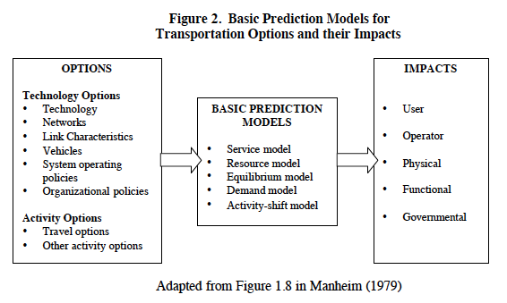
Dodder, 2000

Slide 29
TRANSITIONS (1/4)
No. | From | To
1. | Capital Planning | Management and Operations Focus
2. | Long Time Frames | Real-time Control
3. | Urban Scale Planning and Operations | Regional Scale Planning and Operations
4. | Emphasis on Mobility | Emphasis on Accessibility (the Transportation/Land Use Connection)
5. | “One Size Fits All” Service | Costumer Orientation Quality Pricing for Service
6. | Allocate Capacity by Queuing | Allocate Capacity by Pricing
Sussman, 2002

Slide 30
TRANSITIONS (2/4)
No. | From | To
7. | Aggregate Methods for Demand Prediction | Disaggregate Methods for Demand Prediction
8. | Episodic Data for Investment Planning | Dynamic Data for Investment Planning (and Operations)
9. | Public Financing for Infrastructure and Operations | Private and Public/Private Partnerships for Financing of Infrastructure and Operations Using Hybrid Return on Investment Measures
10. | Infrastructure Construction and Maintenance Providers | New High Technology Players
Sussman, 2002

Slide 31
TRANSITIONS (3/4)
No. | From | To
11. | Static Organizations and Institutional | Dynamic Organizations and Institutional Relationships
12. | Professional Emphasis on Design of Physical Infrastructure | Professional Emphasis on Transportation as a Complex, Large-scale, Integrated, Open System (CLIOS)
13. | Economic Development | Sustainable Development
14. | Computers are “Just a Tool” | Ubiquitous Computing
15. | Supply-side Perspective | Supply/Demand Equilibrium Framework Systems that Never Reach Equilibrium
Sussman, 2002

Slide 32
TRANSITIONS (4/4)
No. | From | To
16. | Independent Conventional Infrastructure Project | Linked Advanced Infrastructure Projects Requiring a System Architecture
17. | Vehicles and Infrastructure as Independent | Vehicles and Infrastructure as Electronically Linked
18. | Reducing Consequences of Crashes | Crash Avoidance
19. | Modal Perspective | Intermodal Perspective Supply Chain Management
20. | Narrow Transportation Specialists | The New Transportation Professional
Sussman, 2002

Slide 33
REFERENCES
Manheim, M.L. (1979) Fundamentals of Transportation Analysis, Volume 1: Basic Concepts, the MIT Press.
Fricker, J.D. and R.K. Whitford (2004) Fundamentals of Transportation Engineering: A Multimodal System Approach, Pearson-Prentice Hall, New Jersey, USA.
Dodder, R. (2000) The Evolving Systems View of Transportation: Implications for Policy, Research Seminar in Engineering Systems, MIT.
Sussman, J.M. (2002) Transitions in the World of Transportation: A Systems View, Transportation Quarterly, Vol. 56, No. 1, Winter 2002, Eno Transportation Foundation, Washington D.C..
Cascetta, E. (2009) Transportation System Analysis, Springer Optimization and Its Application 29, Springer.

Slide 34

Transportation System Ecology

Slide 35
Quotes – D.E. Azaria, RSENR
I hope that the model helps us to think better but I really try to keep in mind that we can mistake the model for wisdom and it’s not wisdom, it’s just a model.
What we need is people with wisdom in a broad view to see the whole system and what we have most of the time is people who look at the smaller subset of that system.

Slide 36
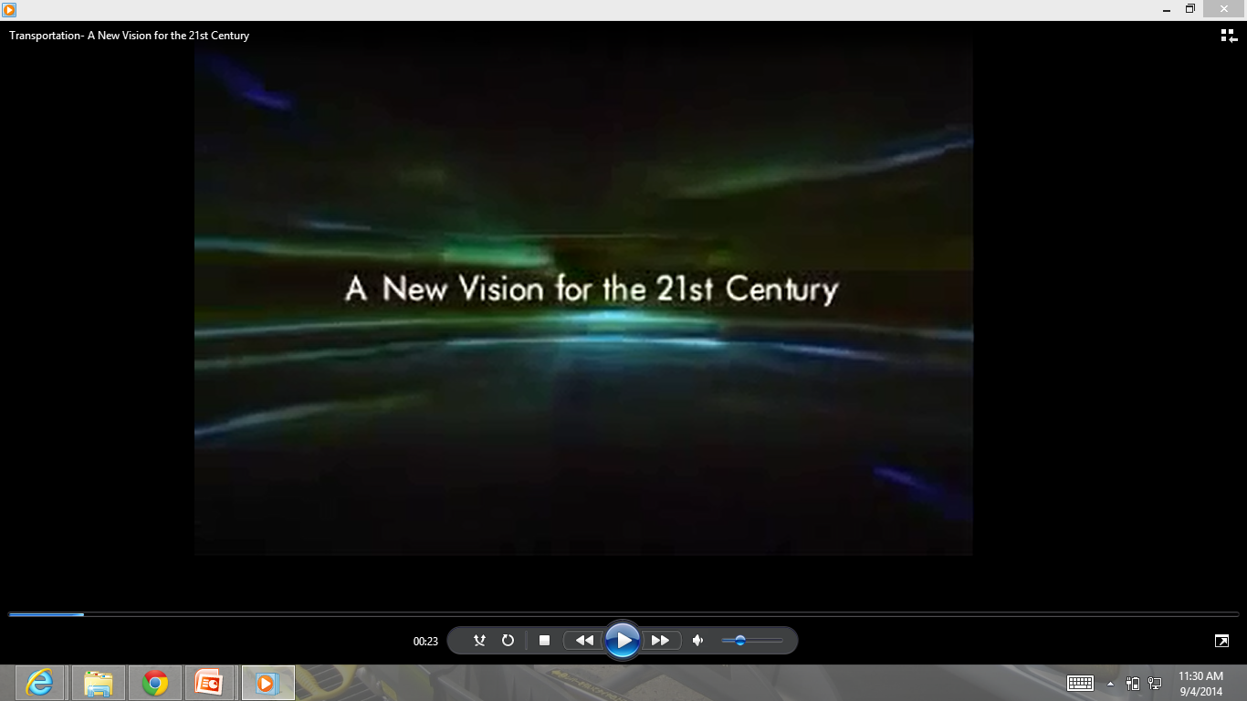
American Transportation Vision

Slide 37
Quotes – W. Millar, APTA
We’re very good in focusing on the cost of everything, not the benefit we derive. Investments in transportation always return more than they cost.

Slide 38


